Slide 1
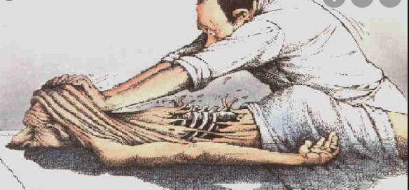
Graded Activity, Pacing, Flare up Planning
Nicola Bailey
Lead Physiotherapist
Chronic Pain Service NHS Highland

Slide 2
Aims of the session
Increase awareness of :
Pain management strategies
Importance of graded exposure to activity and that exercise isn't dangerous when in pain.
Pacing
Flare up planning

Slide 3
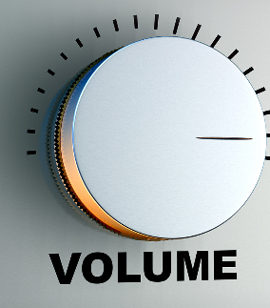
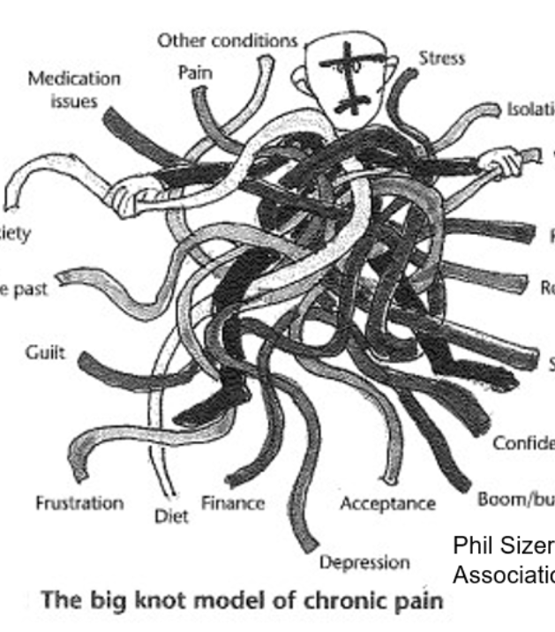
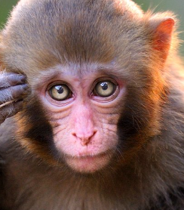
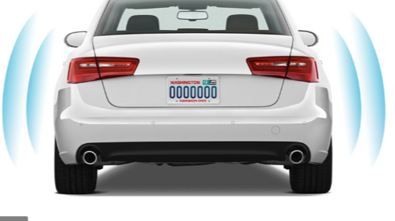
Last session we talked about....
Chronic Pain Sensitive nervous system
Pain system on alert and easily triggered
Viscous circle of triggers and threat
Balance of safety versus threat
Lots of physical and emotional triggers for pain

Slide 4
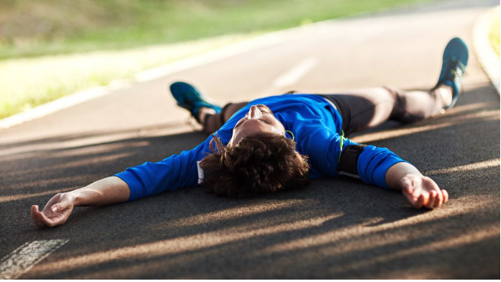
Activity isn't dangerous – exercise can be scary when in pain
Important message activity is not dangerous
But needs to be started at low level and increased gradually due to sensitivity of the nervous system and perceived threat. Tailored to person's needs.
Simple changes can make all the difference over time.
Help to turn the volume down to pain system, release endorphins, improved mood, stamina fitness and strength, social.
Link to a valued activity such as spending time with grandchildren.

Slide 5
Type of patients that struggle with activity:
Boom/ Bust patients / "strivers" type A / Previously High functioning patients struggle to adapt when develop CP
Often high Expectations, driven push themselves to the limit, rarely ask for help, not accepting pain or own limitations, sets goal too high, based on previous level of abilities and "should" be able to do.
Doesn’t communicate well with family friends on their pain, embarrassed shame of asking for help, guilty sense of hopelessness.
Usually reach burn out
Poor self-compassion, self-soothing.
No pain no gain attitute common – Diffusing these beliefs, reassurance and education

Slide 6
Fear avoidance
Fear avoiders/ lacks drive low motivation/ avoid as fear making pain worse/ low activity less, poor self-compassion, feeling of hopeless guilt and viscous cycle of doing less and less due to pain and lack of fitness.
Spend more and more time resting and flare up very easily over time with minimal effort.
Tends to avoid doing much, may hardly even leave the house.
Fear avoidance behaviour when moving, may link to beliefs surrounding their pain " I may end up in wheelchair" I was told my back is crumbling" - reassurance and education . Pain Catastrophising beliefs/ behaviours. Defusing threatening beliefs key
Hypervigilance and avoidance all leading to a cycle of pain and limited function, disability, disuse and low mood.

Slide 7
Where to start?
Choose an Activity they enjoy or did enjoy, such as walking, tai chi, cycling.
Set a baseline level that will not flare up pain - ( set baseline half they would manage on a bad day)
Aiming to sneak in on sensitive pain system and desensitise by exposure, increase fitness muscles strength, stamina, health benefits, release of endorphins, turn down volume to pain and improve mood
Plan for barriers weather, mood, bad days, support from others.
If it's bad weather / or bad day have indoor activity to keep activity up.
E.g indoor walk or tai chi in sitting on bad days

Slide 8
Pacing
Pacing Charts to help work out own pattern / triggers . Problem solve / plan/ realistic goal setting/ white boards
Simple changes breaking up activity/ Sharing / prioritising tasks
Asking for help from those around them, when required
Better communication with others
Saying no when required
Lowering own expectation of self

Slide 9
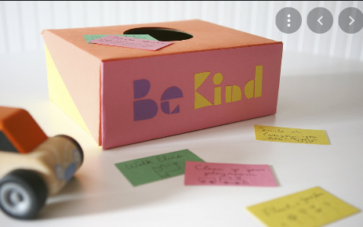
Flare up's
A Flare-Up refers to a period of intense pain which is felt more severely to the day-to-day chronic pain. Flare-Ups may last hours or days and often there is no set pattern to them.
Proactive rather than just reactive to flare up's:
a) minimise the risks of having a Flare-Up
b) manage a Flare-Up
c) learn from having a Flare-Up.
They often come on quickly and without much warning, so they can be worrying and difficult to cope with.

Slide 10
Flare up plans / box

Slide 11
Resources
NHS Intranet Chronic pain page – workbooks and videos
Pain association – have self-help videos / courses
LGOWIT
Flippin pain
Highland info Website

